Slide 1
Genome assembly Bioinformatics Applications (PLPTH813)
Sanzhen Liu
3/23/2023

Slide 2
phylogenetic trees
Phylogenetic methods
Distance-based
Character-based
least square
minimum evolution
neighbor joining
maximum parsimony
maximum likelihood
Bayesian inference

Slide 3
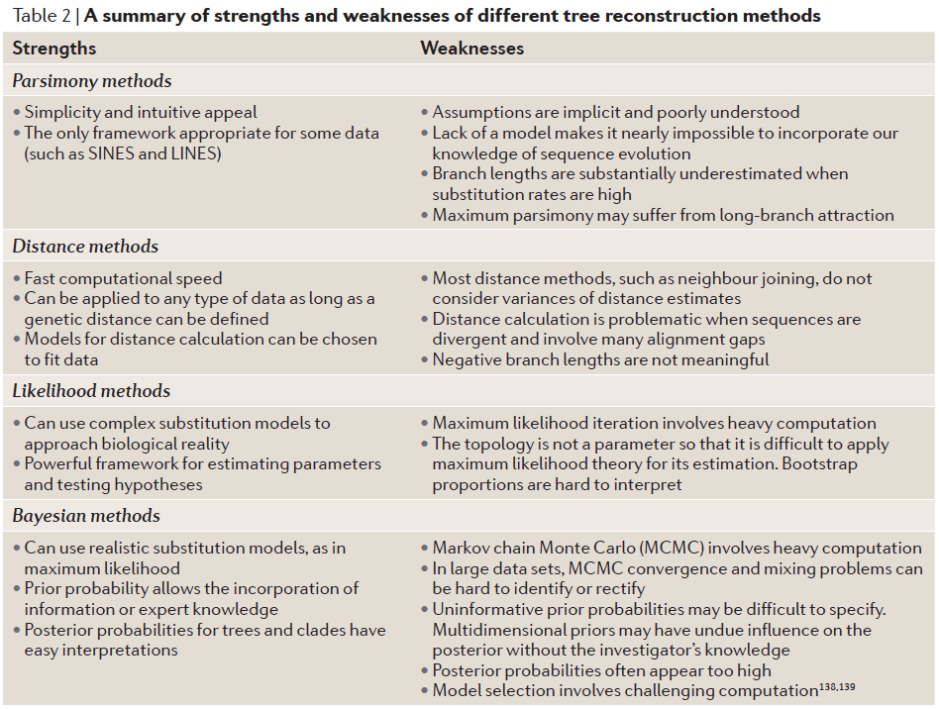
Strengths and weaknesses

Slide 4
Outline
Genome assembly: concept
Assembly algorithms: OLC/De Bruijn graph
Error correction (k-mer counts)
Assembly strategy to cope with the repeat problem
Assembly evaluation (N50, comparison to a reference genome)
Long-read genome assembly
Genome annotation
Case study

Slide 5
Whole genome shotgun (WGS) sequencing
chromosome
sequencing
reads

Slide 6


Complexity of genome assembly
criticalmiami.com/
dreamstime.com
Algorithm Can Solve 10, 000 Piece Jigsaw in 24 Hours

Slide 7
Genome assembly
sequencing
reads
unitigs, superreads
contigs
scaffolds
NN..NN
complete assembly / pseudochomosome

Slide 8
Assembly algorithms
Overlap layout consensus (OLC)
all-to-all pair-wise read alignments
Construct graph based on overlaps
Trace paths for the assembly
De Bruijn graph
Determine k-mer from reads
Construct k-mer graph
Trace paths for the assembly

Slide 9
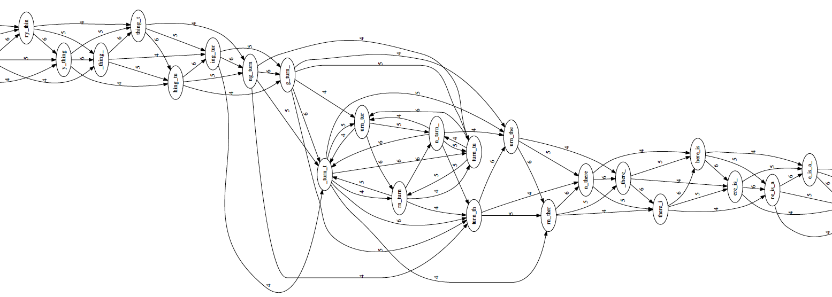
Overlap layout consensus (I)
Overlap graph
to identify all pairs of reads that overlap sufficiently well
to organize the overlapping information into a graph containing a node for every read and an edge between any pair of reads that overlap each other.
Overlap
Layout
Consensus
to_every_thing_turn_turn_turn_there_is_a_season
l = 4 (minimum overlap)
k = 7 (read length)
langmead-lab.org/teaching-materials

Slide 10
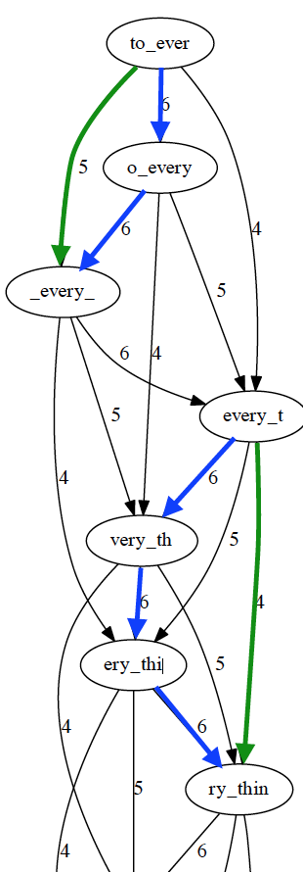
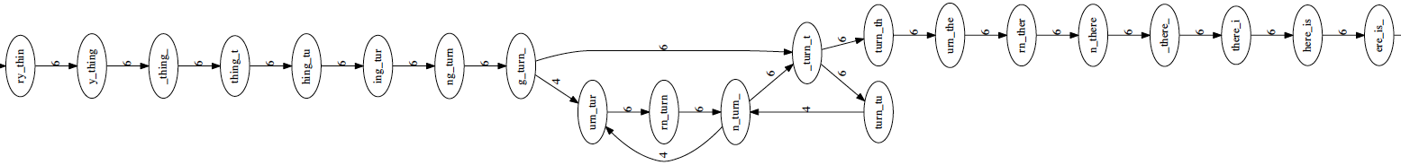
Overlap layout consensus (II)
Overlap
Layout
transitive edges: edges that skip one or more nodes
Consensus
Layout (string graph)
to simplify the global overlap graph by removing redundant information (transitive edges)
langmead-lab.org/teaching-materials

Slide 11
Simplification of the overlap graph
1
Read alignment
2
3
4
Overlap graph
1
2
3
4
Simplify graph by removing transitive edges
1
2
3
4

Slide 12
Overlap layout consensus (III)
Overlap
Layout
Simplifies the global overlap graph by removing redundant information
Emits contigs corresponding to the non-branching paths
Layout
Consensus
contig 1
to_every_thing_turn_
unresolved repeat
(gap)
contig 2
turn_there_is_a_season
to_every_thing_turn_turn_turn_there_is_a_season
langmead-lab.org/teaching-materials

Slide 13
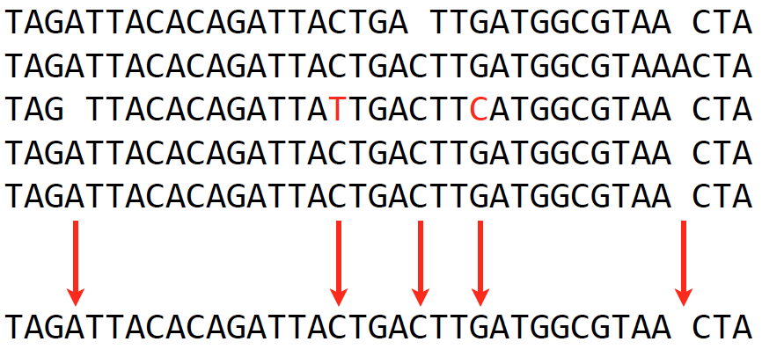
Overlap layout consensus (IV)
Overlap
Consensus
Extract consensus sequences (major votes) based on the alignment of reads that make up a contig
Layout
Consensus
langmead-lab.org/teaching-materials

Slide 14
OLC drawbacks
Identifying all-to-all overlaps is a slow procedure, especially when read number is millions or billions.
Overlap graph is big when the read number is huge. One node per read, and in practice the number of edges grows superlinearly with the number of reads.
The computational complexity limits its application.

Slide 15
De Bruijn graph – k-mer
De Bruijn graph assemblers model the relationship between exact substrings of length k (k-mer) extracted from input reads.
(k=3)
reads
A T G G C G T
k-mer (k=3)
ATG
TGG
GGC
GCG
CGT
Compeau et al., 2011. Nature Biotechnology 29: 987-991.

Slide 16
Problem: list all unique K-mers (k=4)
CGATCGATCGATCGAT

Slide 17
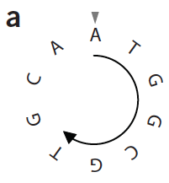
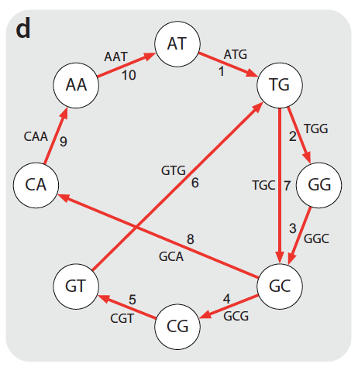
De Bruijn graph - assembly
k-mer (k=3)
genome
sequence
C
ATG
TGG
GGC
GCG
CGT
GTG
TGC
GCA
CAA
AAT
De Bruijn graph
b
ATGGCGT
GGCGTCG
CTTGCAA
TGCAATG
CAATGGC
ATGGCGT
reads
edge
ATG
AT
TG
ATGGCGTGCAATG
Node
Compeau et al., 2011. Nature Biotechnology 29: 987-991.

Slide 18
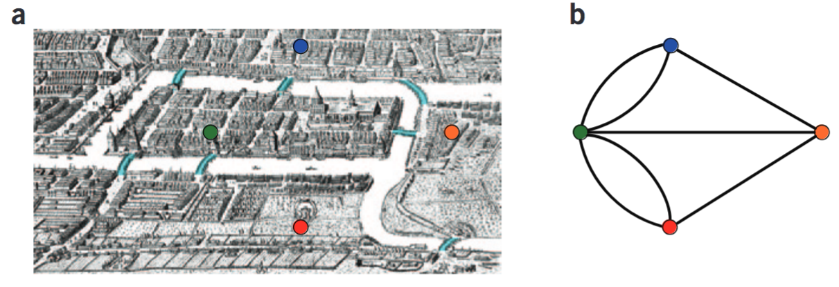
de Bruijn algorithm
To find a path containing all k-mers but also is as short as possible, as it contains each k-mer exactly once.
De Bruijn answered this question by borrowing Euler’s solution of the Bridges of Königsberg problem. An Eulerian cycle represents a shortest path that contains each k-mer exactly once.
Compeau et al., 2011. Nature Biotechnology 29: 987-991.

Slide 19
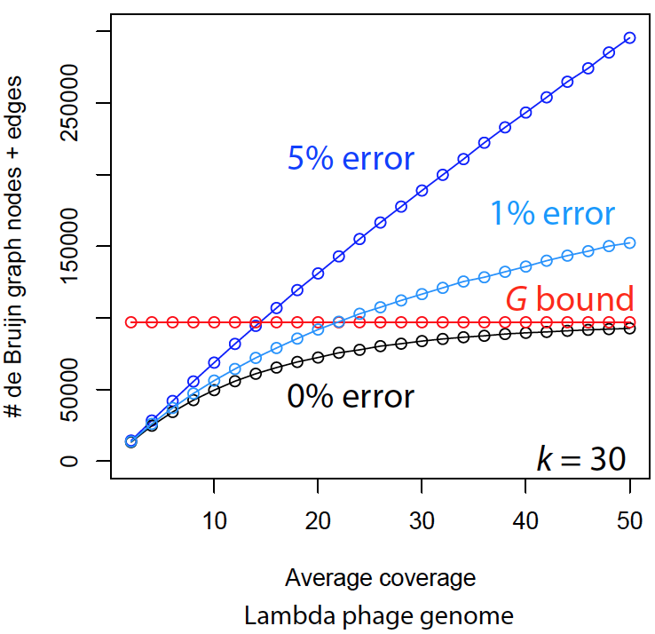
Sequencing errors complicate assemblies
The complexity of De Bruijn graph grows when reads contain errors.
Reads
TGCGTGA
TGCGTGA
TGCGTGA
TGGGTGA
k-mer count profile (k=5)
G: genome
TGCGT
GCGTG
CGTGA
TGGGT
GGGTG
GGTGA
langmead-lab.org/teaching-materials
Sequence error correction before graph construction is a critical step for De Bruijn graph assembly.

Slide 20
Error identification
Reads (depth = 10)
k-mer count profile (k=5)
TGCGTGATACG
TGCGTGATACG
TGGGTGATACG
TGCGTGATACG
TGCGTGATACG
TGCGTGATACG
TGCGTGATACG
TGCGTGATACG
TGCGTGATACG
TGCGTGATACG
TGGGT 1
GGGTG 1
GGTGA 1
TGCGT 9
GCGTG 9
CGTGA 9
GTGAT 10
TGATA 10
GATAC 10
ATACG 10

Slide 21
Error identification
Reads (depth = 10)
k-mer count profile (k=5)
TGCGTGATACG
TGCGTGATACG
TGGGTGATACG
TGCGTGATACG
TGCGTGATACG
TGCGTGATACG
TGCGTGATACG
TGCGTGATACG
TGCGTGATACG
TGCGTGATACG
TGGGT 1
GGGTG 1
GGTGA 1
TGCGT 9
GCGTG 9
CGTGA 9
GTGAT 10
TGATA 10
GATAC 10
ATACG 10
k-mer count profile indicates where errors are.

Slide 22
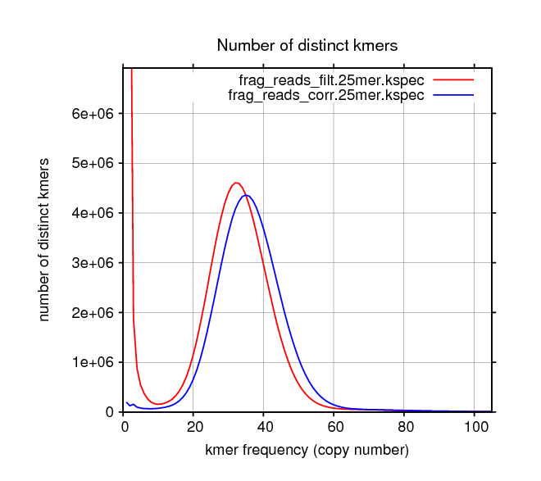
Error correction
Essentially, the error correction algorithm removes k-mers with a few copies and correct reads carrying these errors.
uncorrected reads
corrected reads
from Allpaths-LG

Slide 23
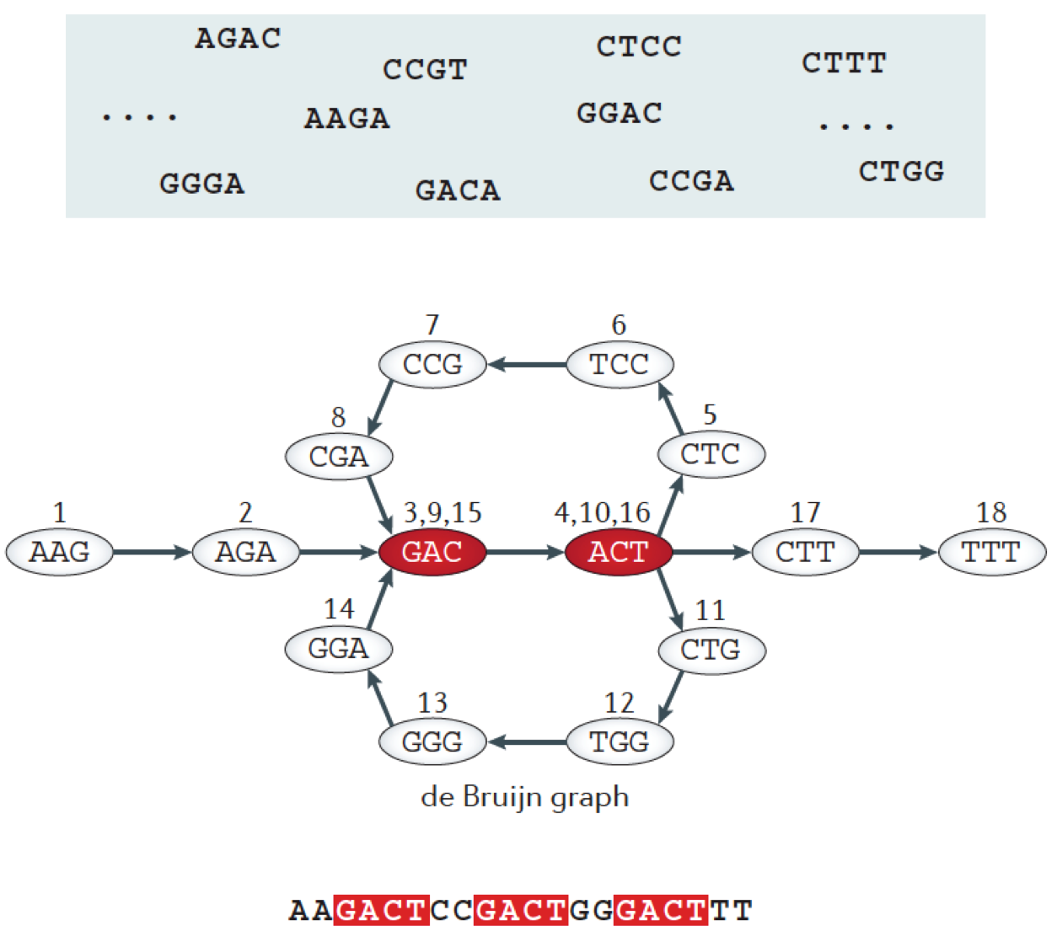
Repeats
Berger, B., et al., 2013 Nature Reviews Genetics 14: 333-346.

Slide 24
Unresolved repeats produce gaps
Long repeats, especially for those whose lengths are longer than read length, and high-copy repeats are challenging to resolve. If no other information can be used to assist in resolving repeats, gaps will be introduced.
What strategies can be used to resolve repeats?
Miller et al., 2010. Genomics 95: 315-327

Slide 25
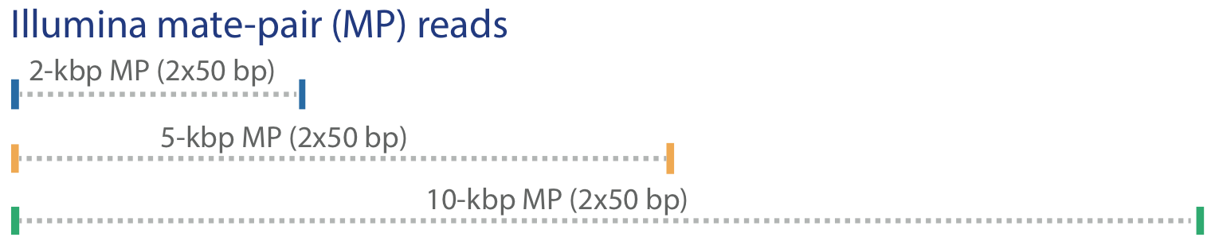
Some strategies to resolve repeats
Mate-pair reads, long reads (e.g., PacBio), genetic map, Hi-C data, and physical map (BioNano) can resolve some repeats
Miller et al., 2010. Genomics 95: 315-327

Slide 26
Gaps due to other reasons
Low sequence coverage (depth)
Sequencing biases (e.g., regions recalcitrant to sequencing)
CGGATCTGCGTGATACGGAATAGCCTAGCA
GATCTGCGTGATACGGAAT
ATCTGCGTGATACGGAATA
TCTGCGTGATACGGAATAG
CTGCGTGATACGGAATAGC
TGCGTGATACGGAATAGCC
CGTGATACGGAATAGCCT
6 (coverage; depth)
Recalcitrant genomic regions:
extremely high GC or AT
complicated secondary structure
Preferred genome sequencing reads:
Long reads (long and less bias)
High-quality reads
High sequencing depth (at least 30x)
No sequencing biases

Slide 27
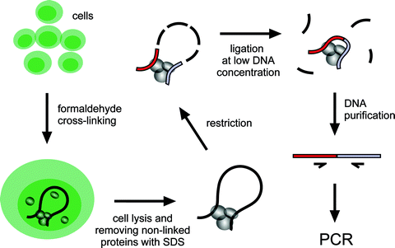
Hi-C: the method to quantify physical interactions between all possible pairs of genomic regions simultaneously
Inside a cell, genomic regions in a chromosome are physically connected to form chromosome conformation. Closer genomic regions generally have higher frequent physical contacts than regions far apart in distance.
MMB, 567:171-188

Slide 28
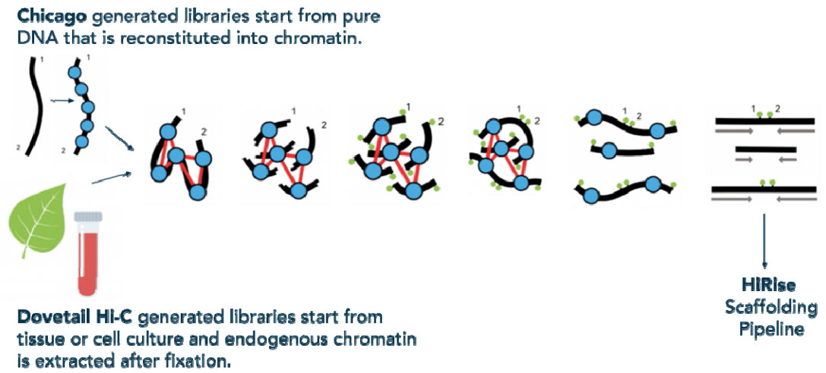
Chicago + Dovetail Hi-C
Chicago generated libraries starting from pure DNA that is reconstituted into chromatin
HiRise scaffolding pipeline
Dovetail Hi-C generated libraries starting from tissue or cell culture and endogenous chromatin
https://youtu.be/OIxFFB3daIM
https://www.biorxiv.org/content/biorxiv/early/2018/08/15/392126.full.pdf

Slide 29
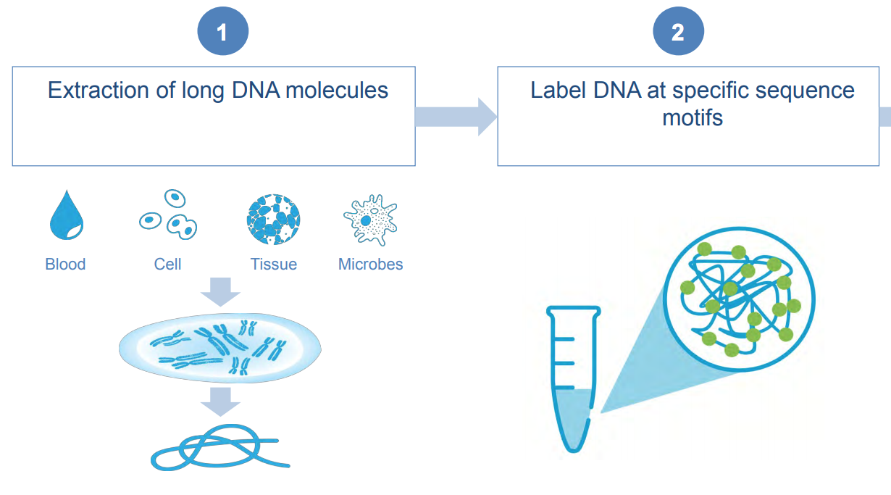
BioNano – library preparation
e.g., DLE-1 (CTTAAG)
Direct label enzyme
https://bionanogenomics.com/wp-content/uploads/2019/03/Bionano-Genomics_Poster_PAG-2019_A-Lee_S-Bocklandt_Hybrid-Scaffold.pdf

Slide 30
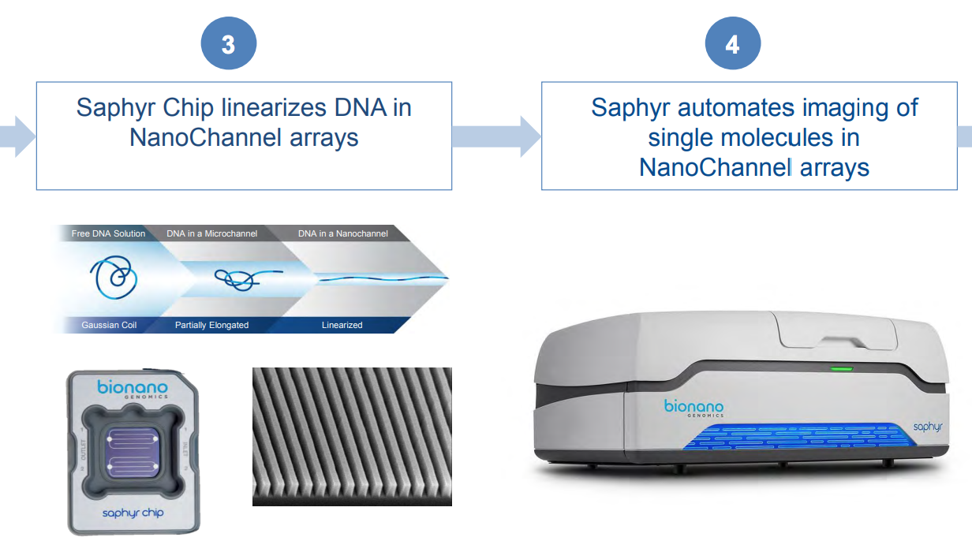
BioNano – running on Saphyr
https://bionanogenomics.com/wp-content/uploads/2019/03/Bionano-Genomics_Poster_PAG-2019_A-Lee_S-Bocklandt_Hybrid-Scaffold.pdf

Slide 31
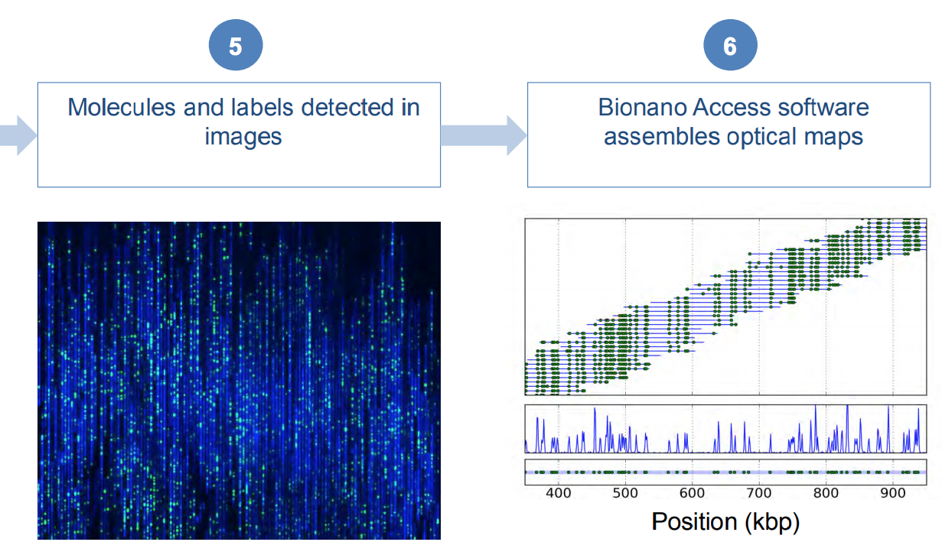
BioNano – image analysis and assembly of molecular data
https://bionanogenomics.com/wp-content/uploads/2019/03/Bionano-Genomics_Poster_PAG-2019_A-Lee_S-Bocklandt_Hybrid-Scaffold.pdf

Slide 32
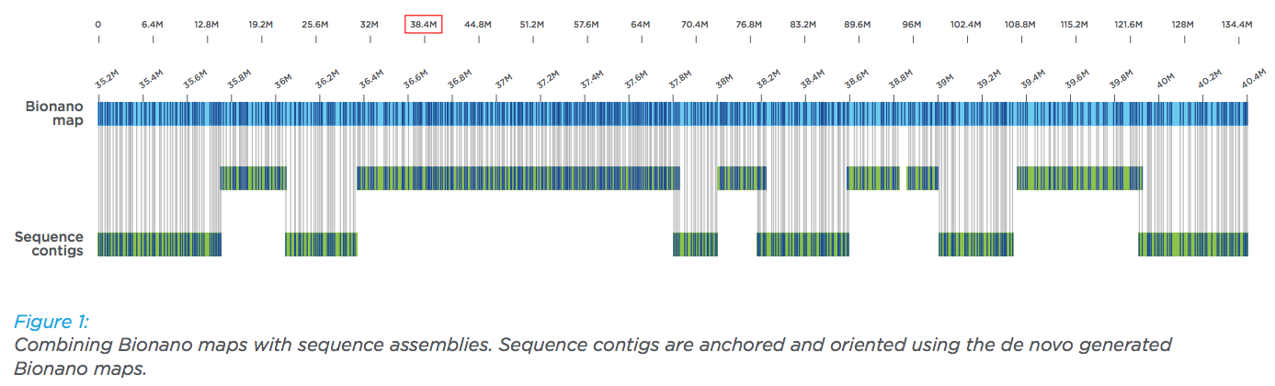
BioNano scaffolding
Matching patterns of DLE-1 (CTTAAG) recognition sites
https://bionanogenomics.com/wp-content/uploads/2017/02/Bionano_HumanPAG_Hybrid-Scaffolding-White-Paper.pdf

Slide 33
Assembly statistics – N50
N50: A statistic used for assessing the continuity of a genome assembly.
The contigs in an assembly are sorted by size and added, starting with the largest. The contig N50 is the size of the contig that makes the total greater than or equal to 50% of the total contig size.
1
2
3
4
Total length of 1-4 >=T/2
5
6
7
8
9
10
11
T=total length (bp)

Slide 34
Assembly statistics – N50 and L50
N50: The contig N50 is the length of the smallest contig in the set that contains the fewest (largest) contigs whose combined length represents at least 50% of the assembly.
L50: The number of contigs whose summed length is N50.
1
2
3
4
L50=4
5
6
7
8
9
10
11
T=total length (bp)

Slide 35
An example to determine N50
Accumulated (kbp) | % ASM
615 | 13%
1,130 | 25%
1,642 | 36%
2,092 | 46%
2,452 | 53%
2,808 | 61%
3,118 | 68%
3,319 | 72%
3,508 | 76%
3,694 | 80%
3,854 | 84%
4,004 | 87%
4,124 | 90%
4,226 | 92%
4,321 | 94%
4,407 | 96%
4,489 | 98%
4,543 | 99%
4,575 | 100%
4,596 | 100%
assembly: 20 contigs
ctg_ID | ctg_size (kbp)
1 | 615
2 | 515
3 | 512
4 | 450
5 | 360
6 | 356
7 | 310
8 | 201
9 | 189
10 | 186
11 | 160
12 | 150
13 | 120
14 | 102
15 | 95
16 | 86
17 | 82
18 | 54
19 | 32
20 | 21
Total | 4,596
contig N50?
360 kbp

Slide 36
Assembly statistics – NG50
Problem of N50:
N50 values of the assemblies with significantly different total assembly space (lengths) are usually not comparable. Even if the same data set is used for the assembly.
50,000
30,000
10,000
50,000
40,000
30,000
20,000
10,000
NG50: The NG50 statistic is the same as N50 except that it is 50% of the known or estimated genome size. This allows for meaningful comparisons between different assemblies.

Slide 37
An example to determine N50 and NG50
Accumulated (kbp) | % ASM | % genome
615 | 13% | 12%
1,130 | 25% | 23%
1,642 | 36% | 33%
2,092 | 46% | 42%
2,452 | 53% | 49%
2,808 | 61% | 56%
3,118 | 68% | 62%
3,319 | 72% | 66%
3,508 | 76% | 70%
3,694 | 80% | 74%
3,854 | 84% | 77%
4,004 | 87% | 80%
4,124 | 90% | 82%
4,226 | 92% | 85%
4,321 | 94% | 86%
4,407 | 96% | 88%
4,489 | 98% | 90%
4,543 | 99% | 91%
4,575 | 100% | 92%
4,596 | 100% | 92%
Genome size: 5 Mbp
20 contigs
ctg_ID | ctg_size (kbp)
1 | 615
2 | 515
3 | 512
4 | 450
5 | 360
6 | 356
7 | 310
8 | 201
9 | 189
10 | 186
11 | 160
12 | 150
13 | 120
14 | 102
15 | 95
16 | 86
17 | 82
18 | 54
19 | 32
20 | 21
Total | 4,596
contig N50 360 bp
contig NG50?
356 kbp

Slide 38
Software for short-read assemblies
Software | Description | URLandreference
Velvet | Original de Bruijn graph assembler | http://github.com/dzerbino/velvet
SOAPdenovo | De Bruijn graph assembler with error-correction step | http://soap.genomics.org.cn/
Meraculous | Hybrid k-mer/read-based | https://jgi.doe.gov/data-and-tools/meraculous/
ALLPATHS-LG | Uses unipath graph to collapse repeats | http://software.broadinstitute.org/allpaths-lg/blog/
SGA | Uses string graphs | https://github.com/jts/sga
ABySS | Represents de Bruijn graph with a Bloom filter | https://github.com/bcgsc/abyss
DISCOVAR de novo | Requires 250-bp PCR-free reads | https://software.broadinstitute.org/software/discovar/blog/
Supernova | Assembles 10× linked reads | https://github.com/10XGenomics/supernova

Slide 39
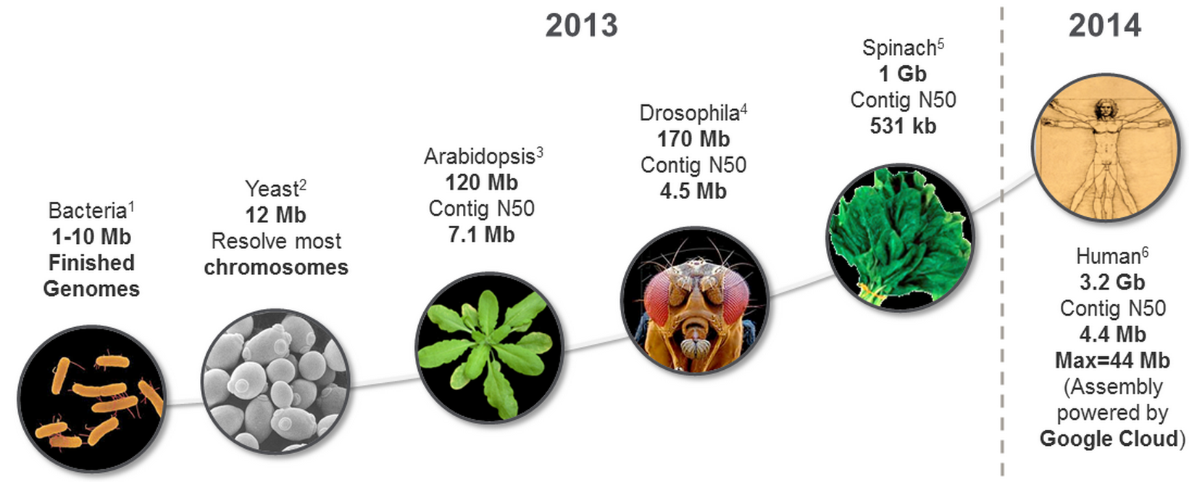
PacBio for genome assembly
PacBio has solved de novo assemblies of most bacterial genomes and it will solve assemblies of small “simple” genomes (e.g., <500 Mbp) with increasing read length and improved sequencing quality.

Slide 40
Long-read assemblies and polishing
Long-read assemblies
Software | Description | URLandreference
HGAP | Error correction, OLC assembly, polishing | https://github.com/PacificBiosciences/Bioinformatics-Training/wiki/HGAP
Canu | K-mer-based overlap computation | https://github.com/marbl/canu
FALCON | Assembles phased diploid genomes | https://github.com/PacificBiosciences/FALCON
Flye | Uses A-Bruijn graph | https://github.com/fenderglass/Flye
Miniasm | Fast, but no error correction | https://github.com/lh3/miniasm
Polishing
Software | Description | URLandreference
Pilon | Uses short-read alignments to correct errors | https://github.com/broadinstitute/pilon
Arrow | Hidden Markov model and long-read alignments (PacBio) | https://github.com/PacificBiosciences/GenomicConsensus
Nanopolish | uses voltage data for correction (Nanopore) | https://github.com/jts/nanopolish

Slide 41
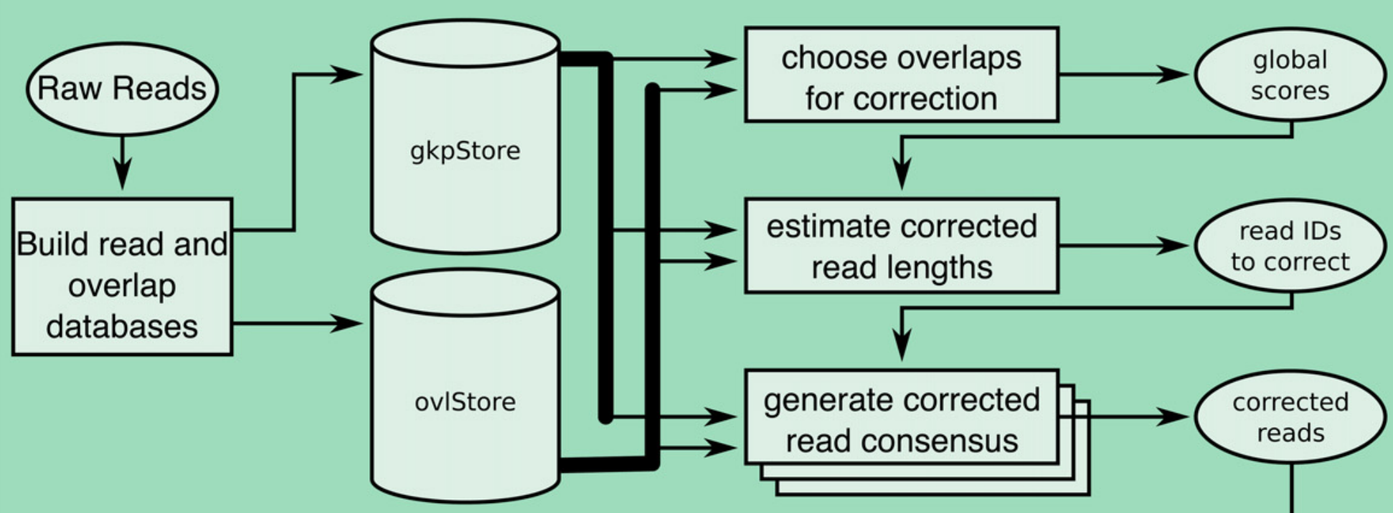
Canu - read correction
Koren et al., Genome Research, 27:722–736 (2017)

Slide 42
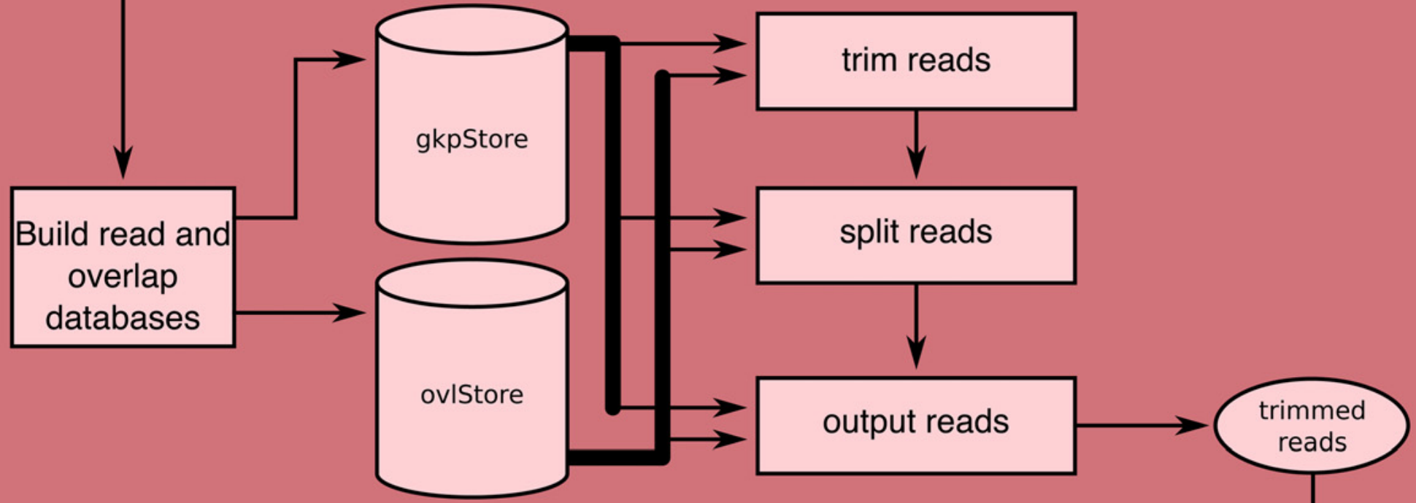
Canu - read trimming

Slide 43
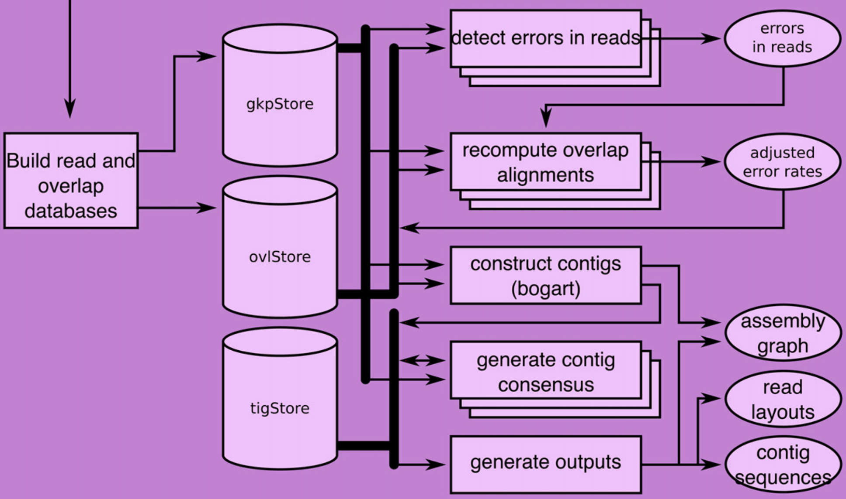
Canu - assembly (consensus and contigs)

Slide 44
Contig polishing
Software | Description
Arrow | Assembly error correction with PacBio long-read alignments
Nanopolish | Assembly error correction using voltage (raw) Nanopore data
Pilon | Assembly error correction using Illumina data

Slide 45


Slide 46
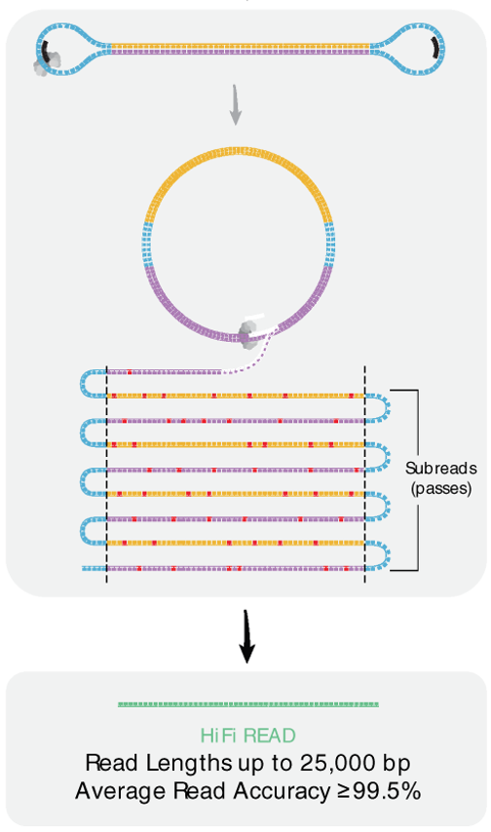
Assembly meets long HiFi PacBio reads
Assembly with hifiasm
_{Dataset} | Maize (B73) | Human (CHM13)
_{Size} | _{2.2Gb} | _{3.1Gb}
_{Coverage} | _{×22} | _{×32}
_{CPU time} | _{203.2h} | _{310.7h}
_{RAM} | _{68G} | _{114G}
_{N50} | _{36.7Mb} | _{88.9Mb}
https://github.com/chhylp123/hifiasm
Scientific Data, 2020, 7:399

Slide 47
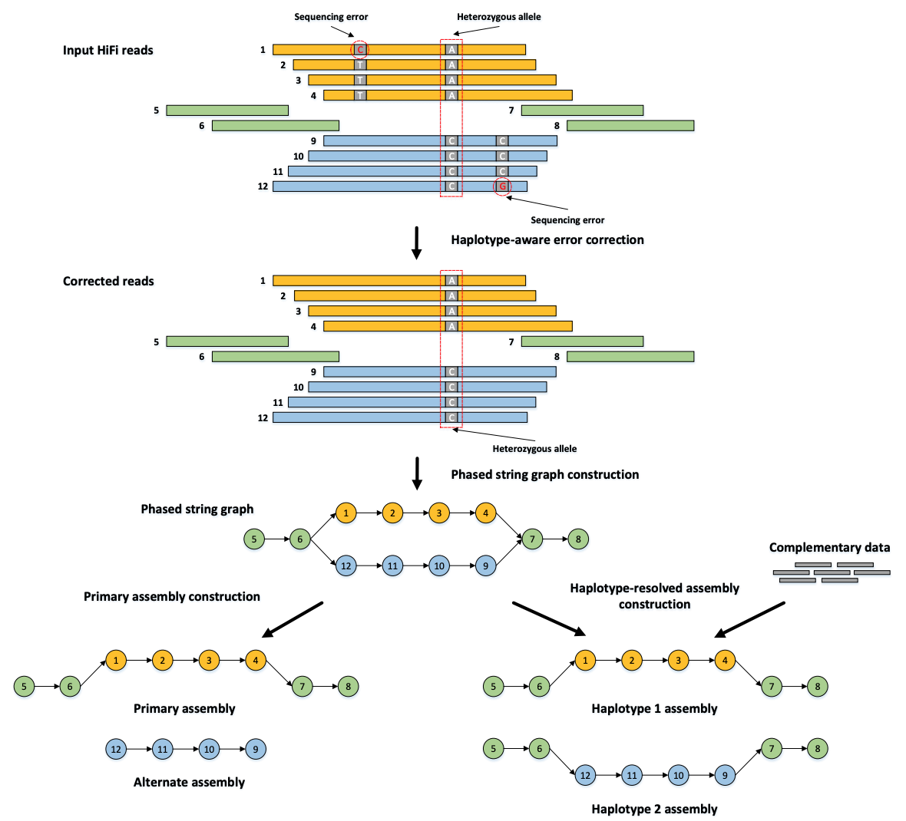
Haplotype-resolved de novo assembly (Phased assembly using hifiasm)
Cheng et al., Nature Methods, 18, 170–175 (2021)

Slide 48
Assemblies are hypotheses
... there will always be some degree of error in the characterized genome sequence, both on the level of individual nucleotides and in the ordering of sequence blocks. ..., every genome assembly is the result of a series of assembly heuristics and should accordingly be treated as a working hypothesis.
Evolutionary Conservation, 7:1026-1042, 2014

Slide 49
Assembly evaluation
No. of contigs: the total number of contigs in the assembly.
Largest contig: the length of the largest contig in the assembly.
Total length: total assembly length
Nxx (N50), NGxx (NG50)
Using a reference genome, No. of misassemblies, No. INDEL per 100 kbp, and No. of mismatches per 100 kbp are reported
Evaluation with BUSCO (Benchmarking Universal Single-Copy Orthologs)
Gurevich et al., 2013 Bioinformatics 29: 1072-1075.

Slide 50
Outline
Genome assembly: concept
Assembly algorithms: OLC/De Bruijn graph
Error correction (Kmer counts)
Assembly strategy to cope with the repeat problem
(mate-pair reads, long reads, others)
Assembly evaluation (N50, comparison to a reference genome)
Genome annotation

Slide 51
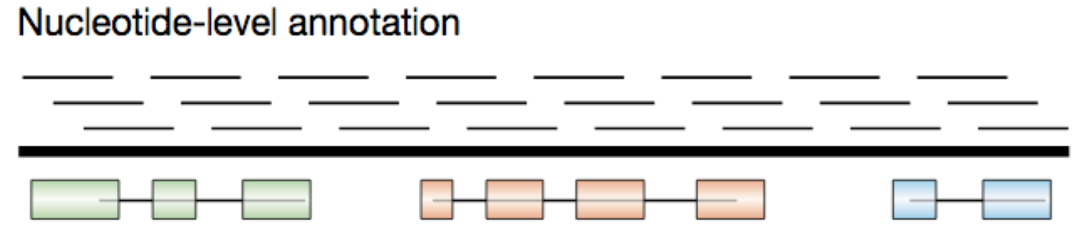
Gene annotation of eukaryotic genomes
Gene prediction from genomic DNA sequences:
to predict the exon-intron structures of the protein-encoding portions of transcripts (open reading frames or ORFs) and untranslated regions (UTR).

Slide 52
Gene prediction approaches
ab initio gene prediction (Hidden Markov Model)
to assign probability scores to many potential coding exons, and then join consecutive high-scoring exons with consistent reading frames to form high-scoring exon–intron structures
Evidence-driven gene prediction (e.g., RNA sequencing data)

Slide 53
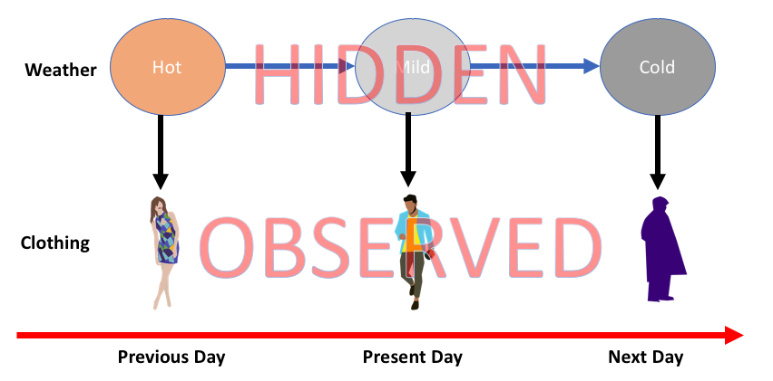
Hidden Markov Model (HMM)
Hidden states
HMM is a class of probabilistic graphical model that is used to predict a sequence of unknown (hidden) variables from observed variables.
https://medium.com/@postsanjay/hidden-markov-models-simplified-c3f58728caab

Slide 54
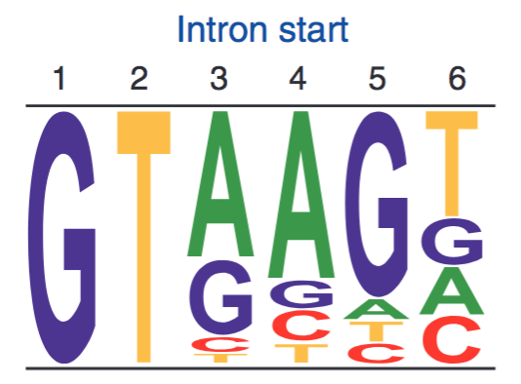
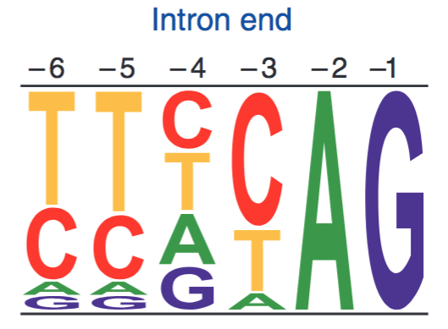
Exon-intron structure
Sequence logos represent weight matrices for the first six bases of an intron (left) and the last six bases of an intron (right). In plants and animals, ~99% of introns begin with GT.
exon
intron
exon
GT
AG
Other genomic sequence patterns: translation initiation and termination sites.
Notes:
termination sites: UAA, UGA, or UAG

Slide 55
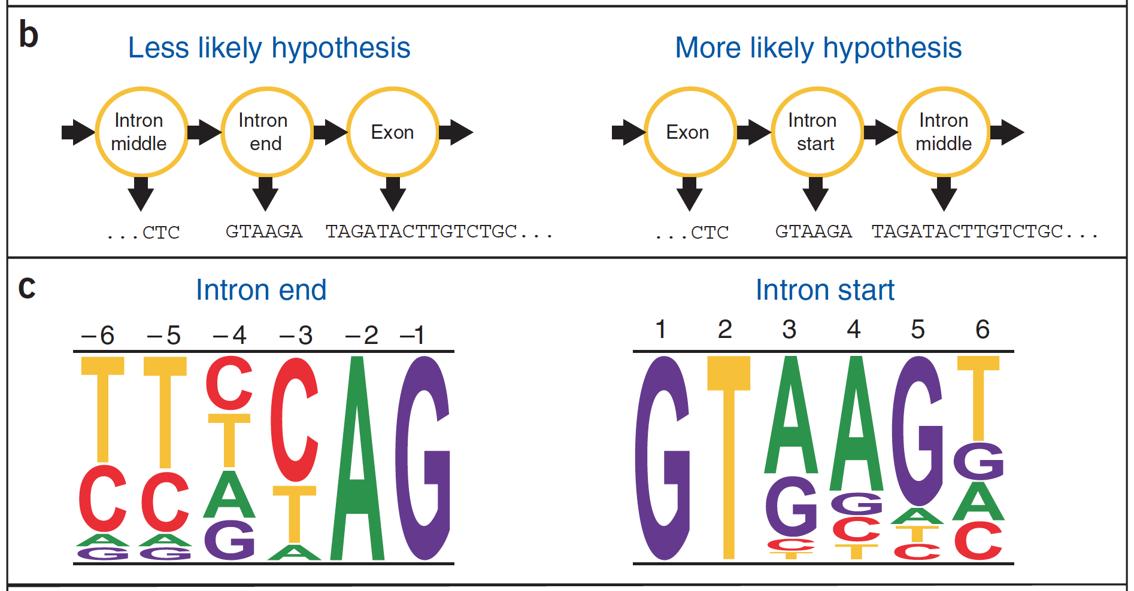
Generalized Hidden Markov Model (GHMM)
…CTCGTAAGATAGATACTTGTCTGC…

Slide 56
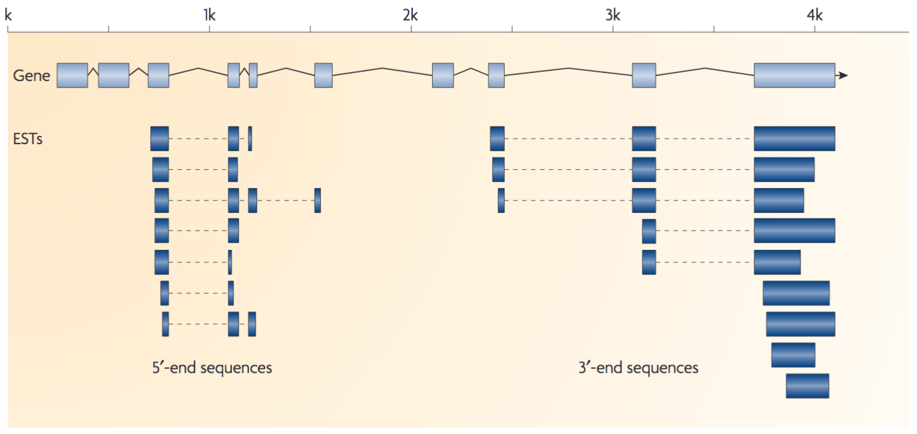
Evidence-driven approaches
Ideally, full-length cDNA sequences of all genes and protein sequences are collected for evidence-based genome annotation.

Slide 57
evidence and limitations
Full-length cDNAs
Protein sequences
Expression sequence tags (ESTs)
RNA-Seq (de novo assembly and alignment-based)
Limitations:
Full-length cDNA databases are not available
Not all genes are transcribed at sufficient levels at certain conditions
Alignments produce errors

Slide 58
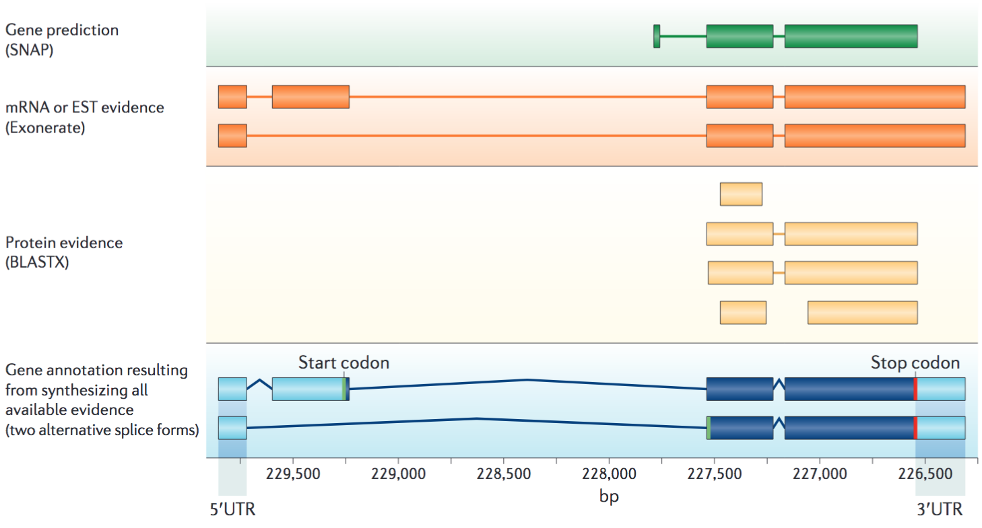
annotation: ab initio prediction + evidence
Nature Reviews Genetics 13:329–342 (2012)

Slide 59
Question?
What method can you figure out to assess the completeness of a genome annotation?

Slide 60
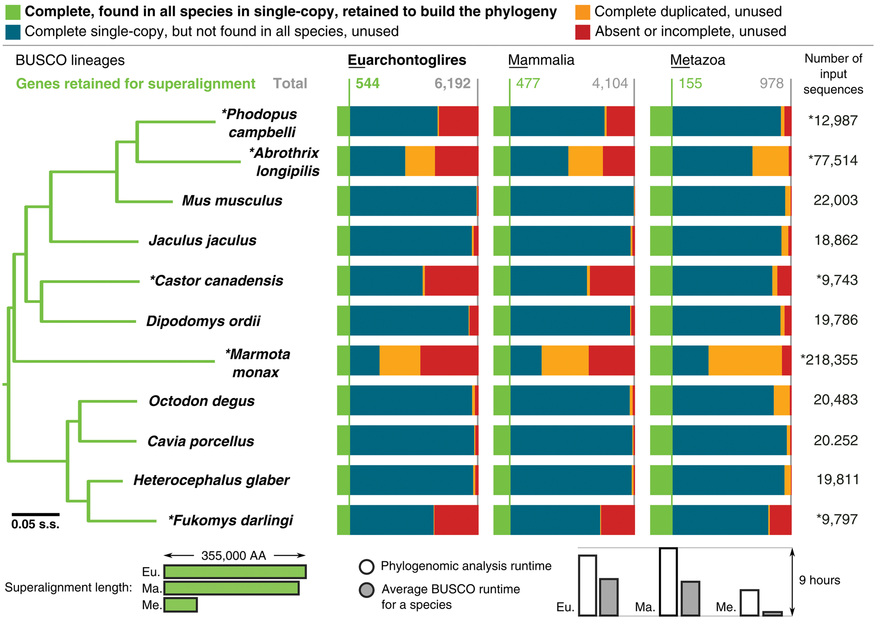
Genome and transcriptome BUSCO assessments to identify universal single-copy genes
Notes:
Fig. 3 Genome and transcriptome BUSCO assessments to identify universal single-copy markers for phylogenomics studies. The phylogeny was generated using the Euarchontoglires results to identify complete single-copy orthologs found in all species for building the superalignment used for maximum likelihood tree reconstruction (Materials and Methods). Mammalia and Metazoa results produced identical tree topologies. Bars below the BUSCO results show how the sizes of the assessment data sets influence the superalignment lengths and the analysis runtimes. The tree was rooted with the rabbit, all nodes have 100% bootstrap support, branch lengths are in substitutions per site (s.s.).
Unless provided in the caption above, the following copyright applies to the content of this slide: The Author 2017. Published by Oxford University Press on behalf of the Society for Molecular Biology and Evolution.This is an Open Access article distributed under the terms of the Creative Commons Attribution License (http://creativecommons.org/licenses/by/4.0/), which permits unrestricted reuse, distribution, and reproduction in any medium, provided the original work is properly cited.

Slide 61
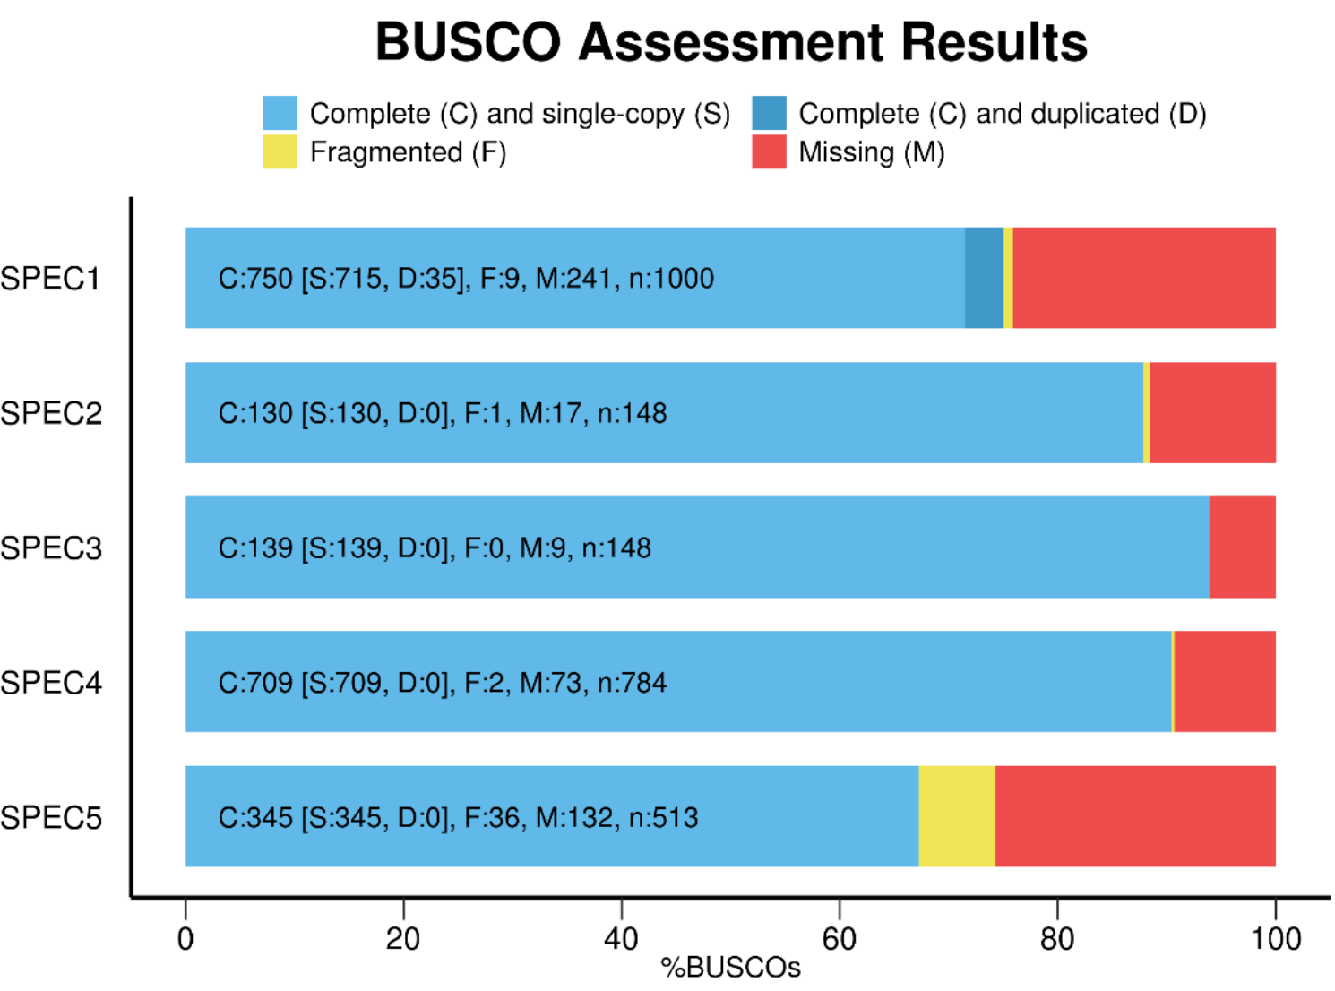
Evaluation with BUSCO
Assessing genome assembly and annotation completeness with Benchmarking Universal Single-Copy Orthologs.
file:///Users/liu3zhen/Downloads/BUSCO_v3_userguide.pdf

Slide 62
Outline
Genome assembly: concept
Assembly algorithms: OLC/De Bruijn graph
Error correction (Kmer counts)
Assembly strategy to cope with the repeat problem
(mate-pair reads, long reads, others)
Assembly evaluation (N50, comparison to a reference genome)
Genome annotation
Case study

Slide 63
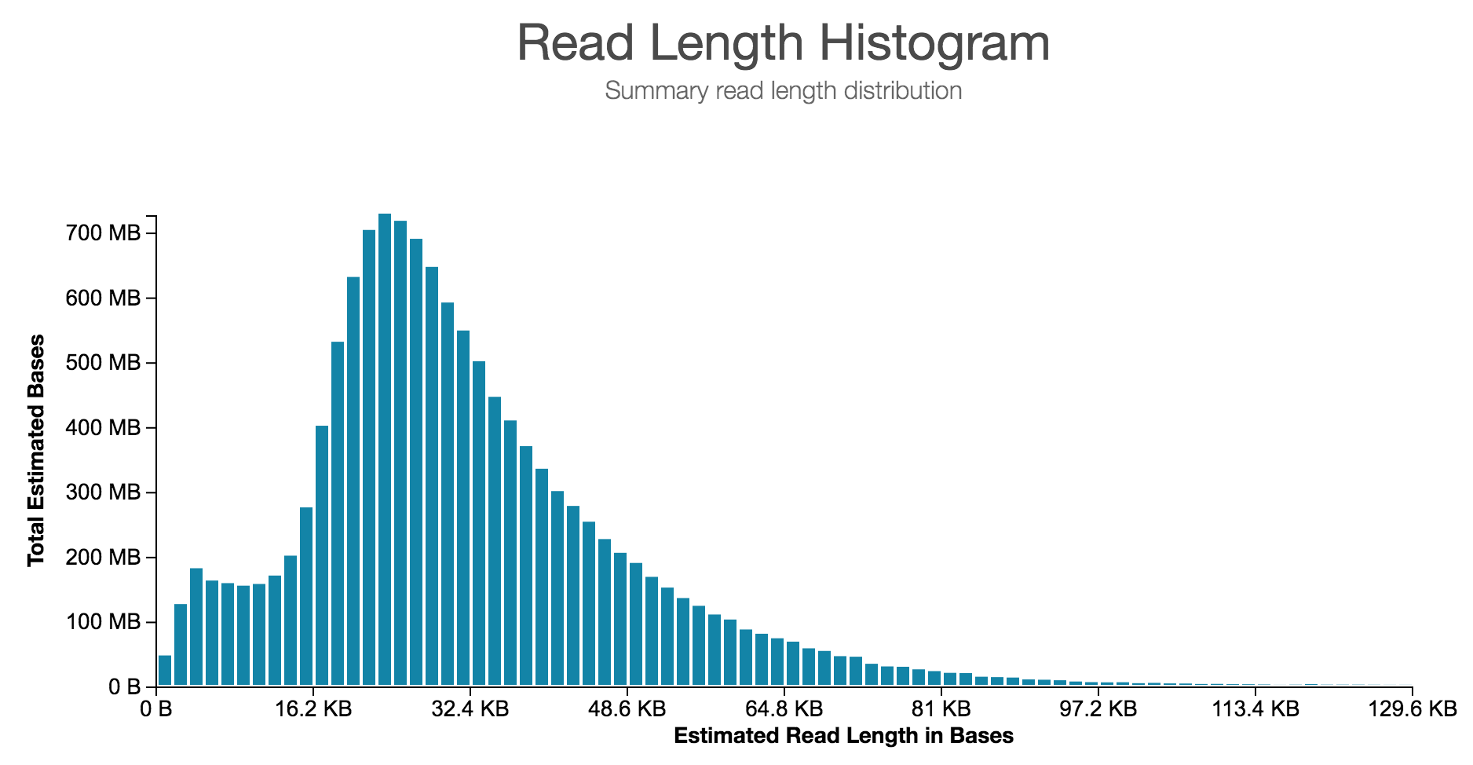
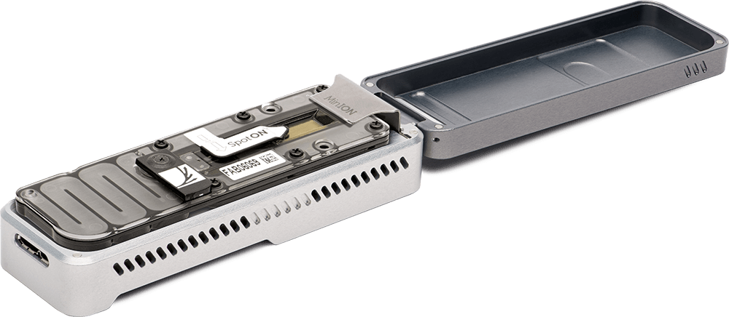
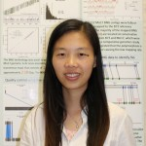
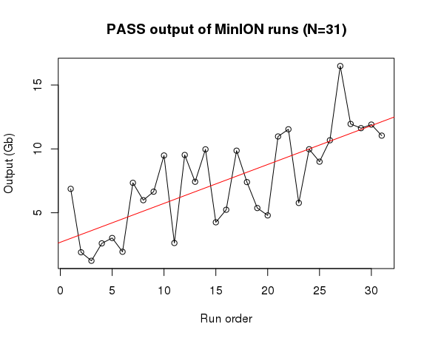
Case 2: Maize genome assembly with Nanopore MinION sequencing
Nanopore
MinION (N=31)
Output: 6-13 Gb per flowcell
error rate: ~10%
FLO-MIN106
SQK-LSK109
Guifang Lin

Slide 64
Assembly strategy
Phase - I
Nanopore long reads (90X)
canu
Chr | Length (bp) | # genes
1 | 307,989,483 | 6,034
2 | 251,027,758 | 4,873
3 | 243,219,806 | 4,313
4 | 255,421,021 | 4,315
5 | 229,324,730 | 4,613
6 | 181,596,323 | 3,412
7 | 183,343,242 | 3,208
8 | 182,018,909 | 3,653
9 | 165,494,689 | 3,082
10 | 153,829,095 | 2,824
mt | 525,405 | 40
pt | 140,437 | 39
Scaffolds (986) | 16,204-2,700,288 | 341
sum | 2,246,851,412 | 40,747
Canu asm, Nanopolish
Illumina (90X)
polishing
Polished contigs
Mt; Pt
Phase - II
BioNano map
GBS of DH lines
hybrid
scaffold
mstmap
scaffolds + contigs
Genetic map
ALLMAPS
pseudochr
scaffolds + contigs

Slide 65
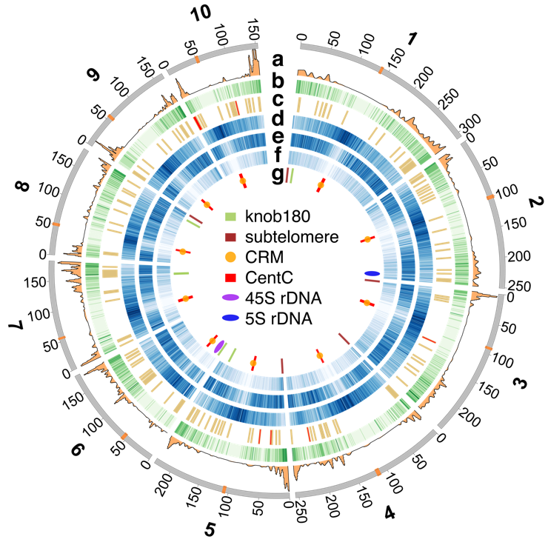
Circos plot to display genomic contents

Slide 66
Citations
Berger, B., J. Peng, M. Singh, Computational solutions for omics data. Nature Reviews Genetics 14: 333-346 (2013).
Compeau, P. E. C., P. A. Pevzner, G. Tesler, How to apply de Bruijn graphs to genome assembly. Nature Biotechnology 29: 987-991 (2011).
Nagarajan, N., M. Pop, Sequence assembly demystified. Nature Reviews Genetics 14: 157-167 (2013).
Miller, J. R., S. Koren, G. Sutton, Assembly algorithms for next-generation sequencing data. Genomics 95: 315-327 (2010).
Brent, M. R. How does eukaryotic gene prediction work? Nat. Biotechnol. 25, 883–885 (2007).
Stein, L. Genome annotation: from sequence to biology. Nat. Rev. Genet. 2, 493–503 (2001).
Yandell, M., Ence, D. A beginner’s guide to eukaryotic genome annotation. Nat. Rev. Genet. 13, 329–342 (2012).
Simão, F. A., et al. BUSCO: assessing genome assembly and annotation completeness with single-copy orthologs. Bioinformatics 31, 3210–3212 (2015).

